Slide 1
STRUCTURES
Made By – Ibrahim Koicha

Slide 2
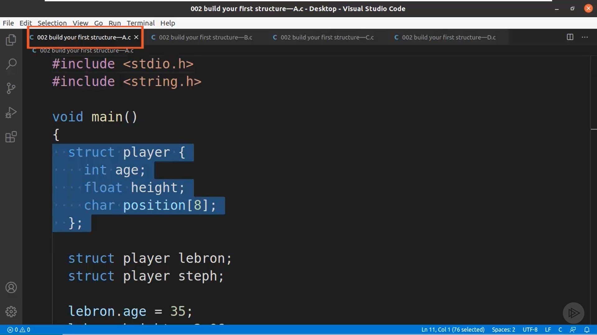
Initializing A Structure
Struct Keyword is used to initialize a Structure

Slide 3
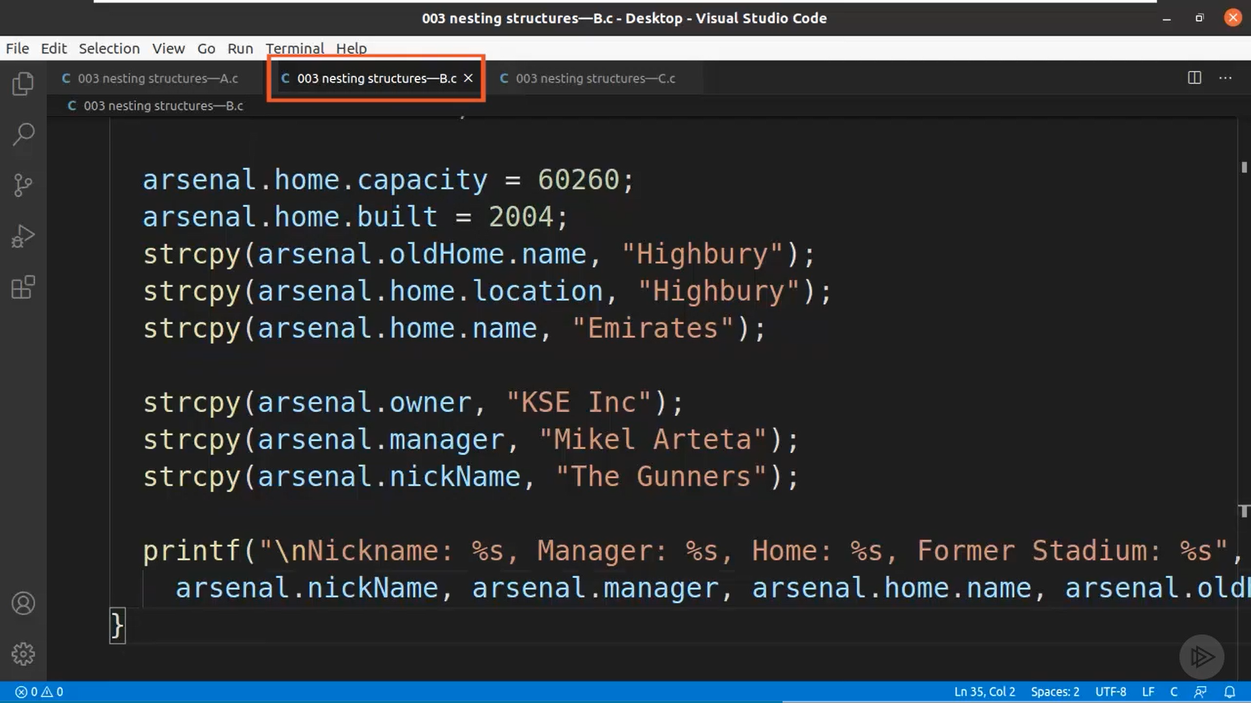
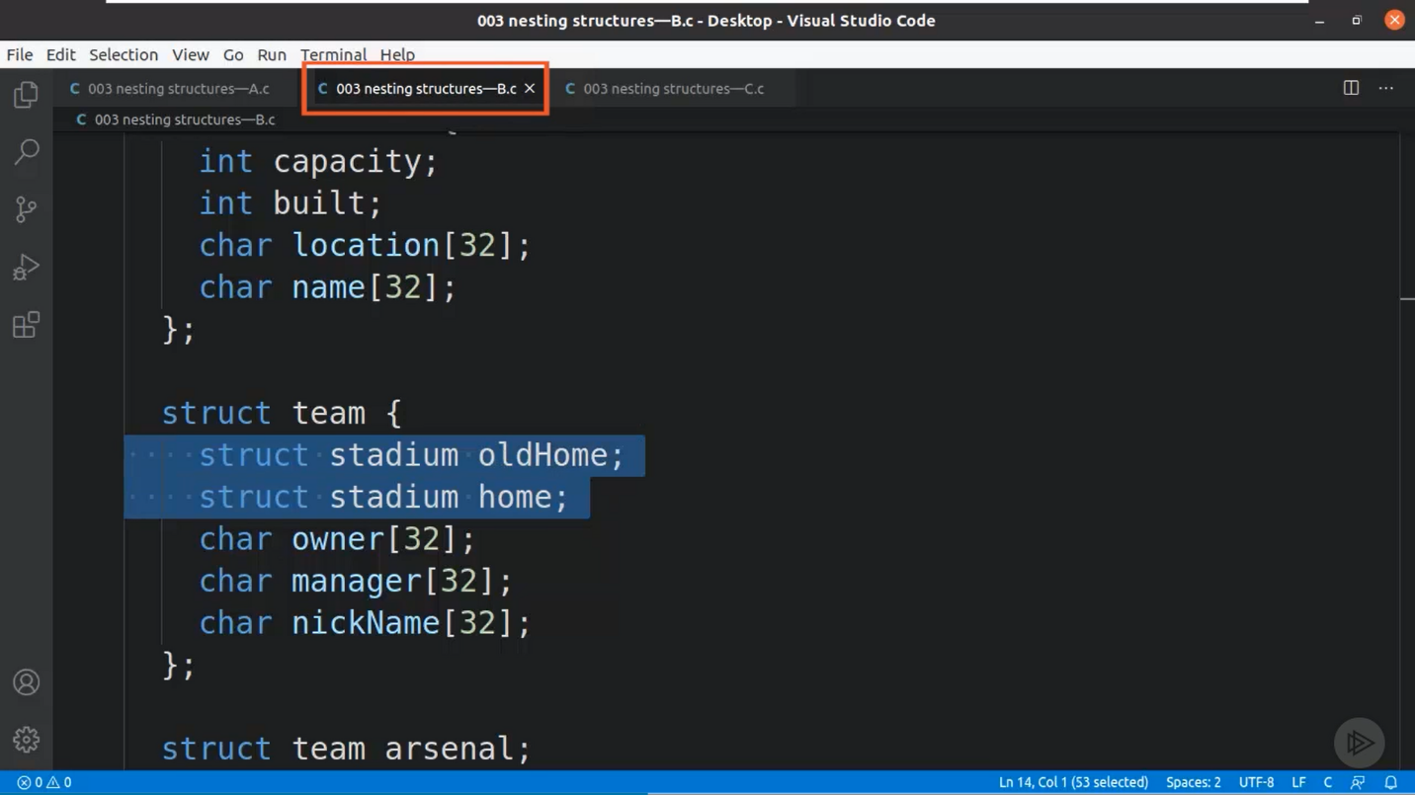
Nested Structures
Structures can be nested as one inside the other.

Slide 4
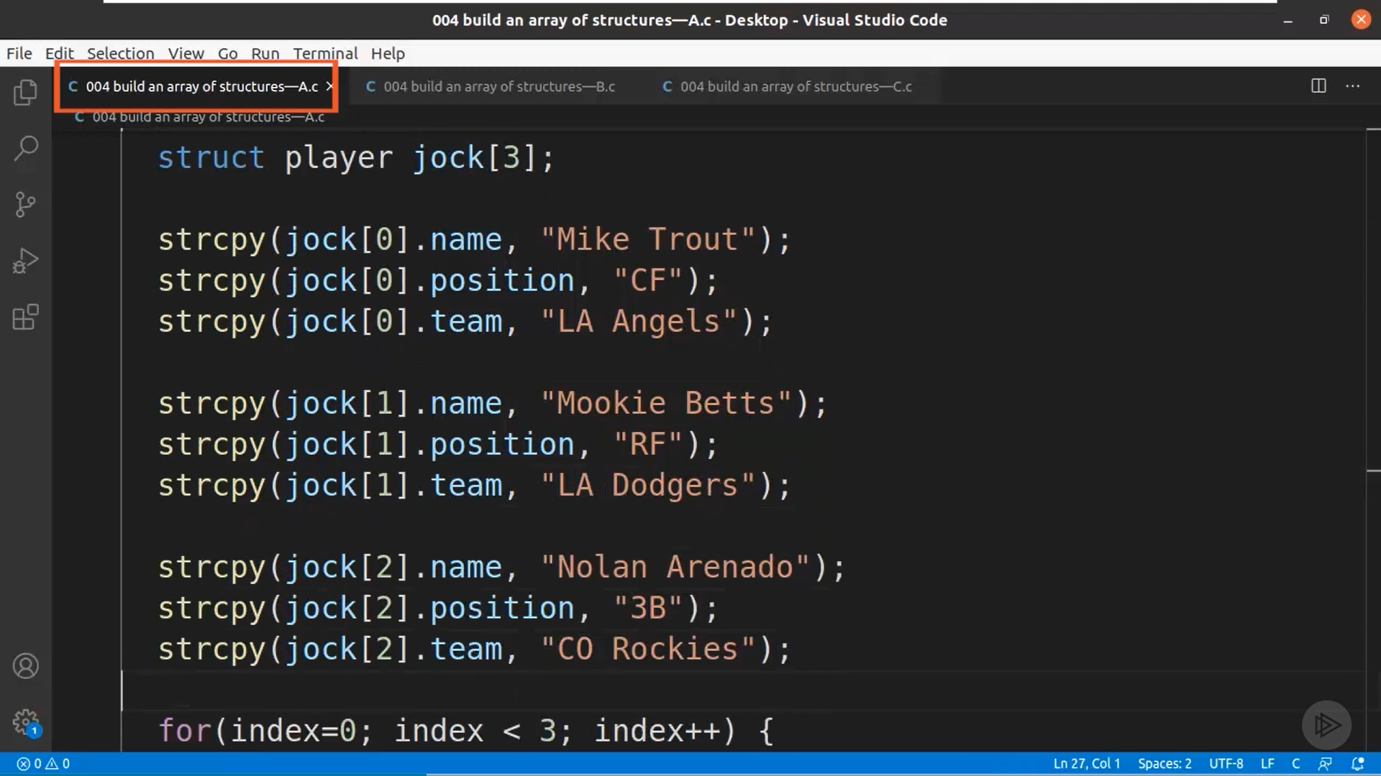
Array of Structures
We can also initialize an Array of Structures.

Slide 5
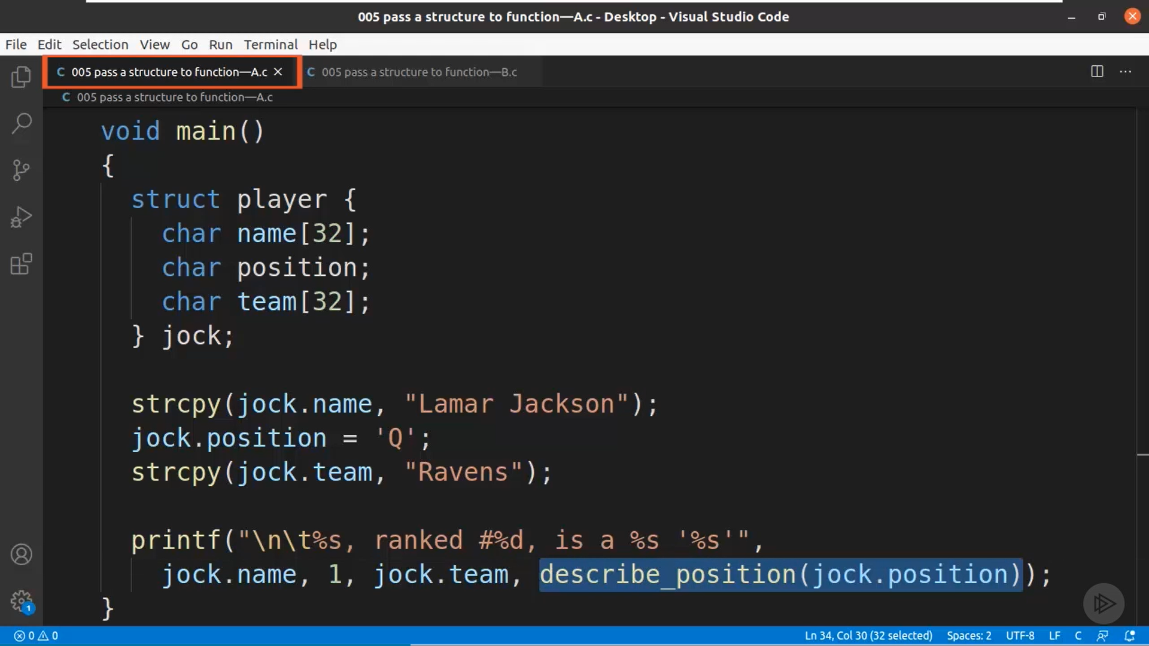
Passing a Structure to a Function

Slide 6
Structure Padding
CPU can read only one word at a time.​
4 bytes for 32-bit compiler and 8 bytes for 64-bit compiler.​
So if the size is suppose 6 bytes of structure then it will need 2 cycles to complete that. So to save that mix-up Padding is used.​

Slide 7
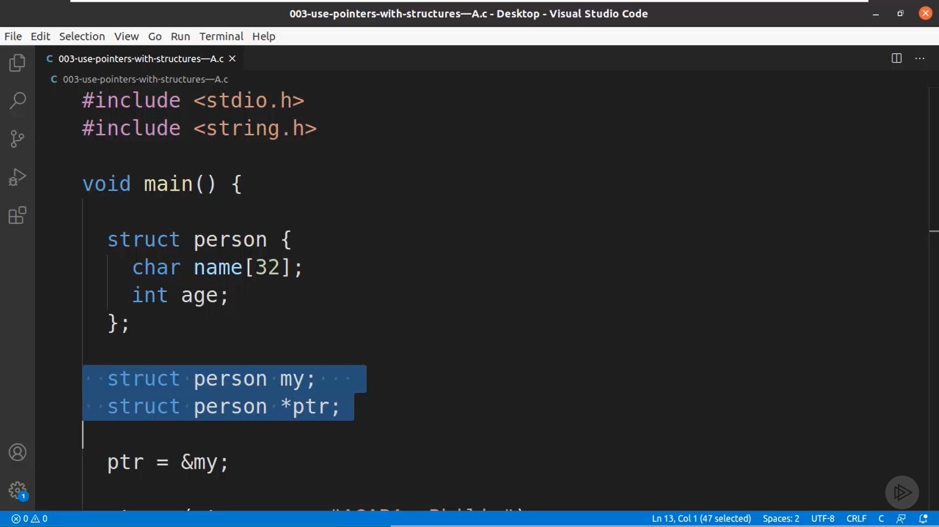
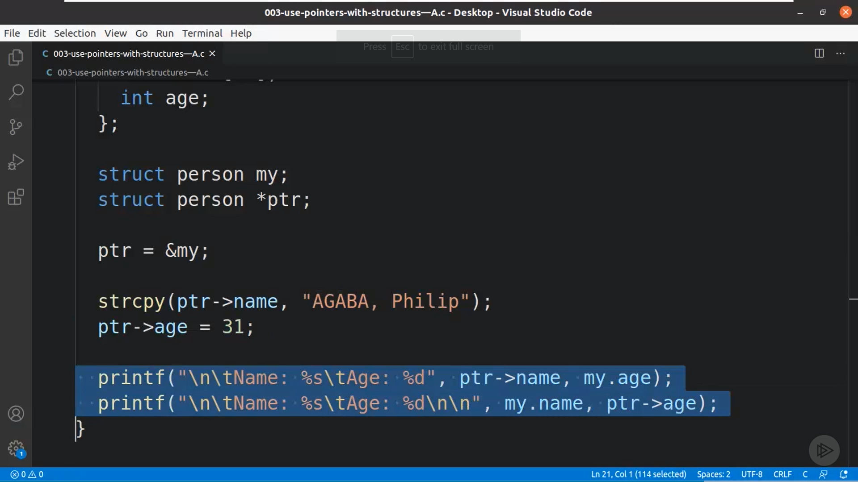
Pointers with Structures
The pointer stores the value of the structure initialized.

Slide 8
Pointers
Pointer – Holds a Memory Location or Address of another variable or contains address of chunk of RAM. Pointer grants access to RAM locations as C is a mid-level language.
Once defined it can be used with and without asterisk
Duality of Pointers
ptr – Address
*ptr – Value at Address

Slide 9
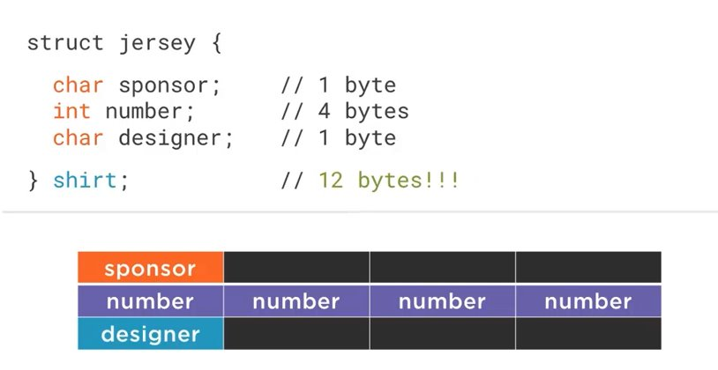
Padding

Slide 10
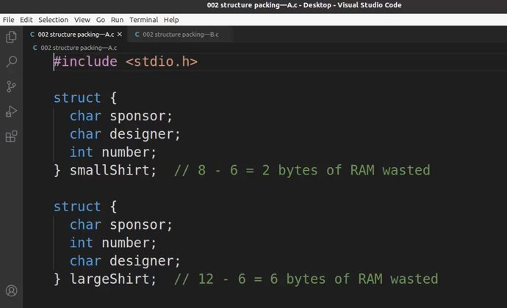
Padding in Structure

Slide 11
Bit Field
Enables Access to Specific Bits
Makes it possible to work with data which is smaller than 8 bits
It can help with Memory Optimization
It can also help with control of hardware
Requires an Integer Data Type

Slide 12

Thank You

